Slide 1
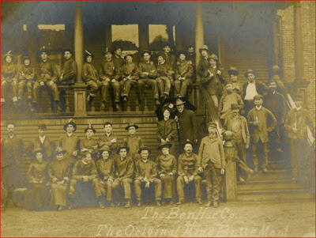
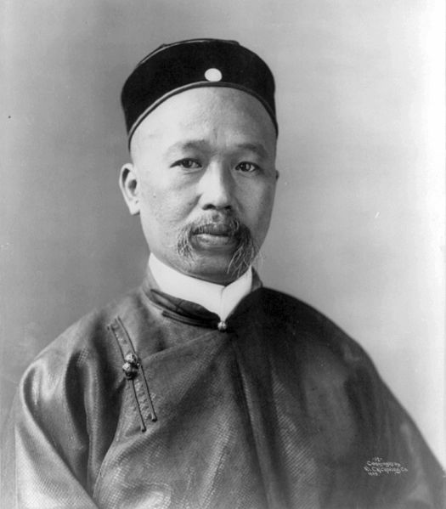
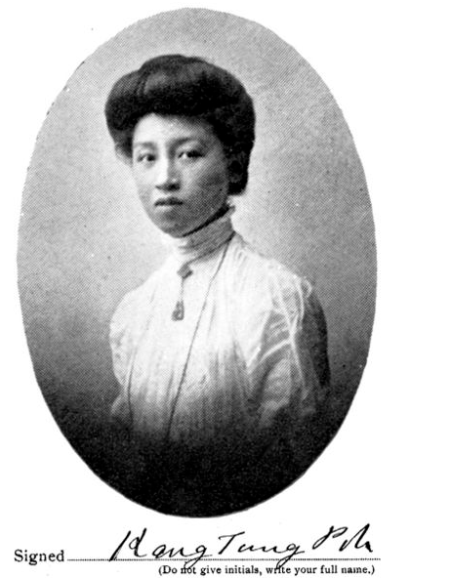
Jane Leung Larson: Substance
Jane Leung Larson
Freelance Writer and Chinese Historian
Goal: Document Chinese History
Notes:
Jane Leung Larson is a writer and Chinese historian. She was born in the U.S. and got her B.A. in Anthropology at Reed College, Portland, Oregon. Since 1985, she has done research on the Baohuanghui. Her grandfather was a student of Kang Youwei, who founded the Baohuanghui. In addition, she is also a founding member of the Northwest China Council, one of 12 regional Councils sponsored by the National China Council of the Asia Society. Currently, she is working on a collaborative project with scholars to update and publish the 1972 dissertation by Robert L. Worden called, “A Chinese Reformer in Exile: The North American Phase of the Travels of K’ang Yu-wei.” Her goal relates to women’s role in US-Asian relations because it is creating an exchange of information between the two cultures. Her work has also taken her to China so she is personally creating a communication exchange between the two nations.

Slide 2
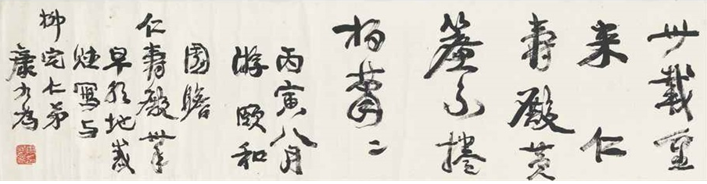
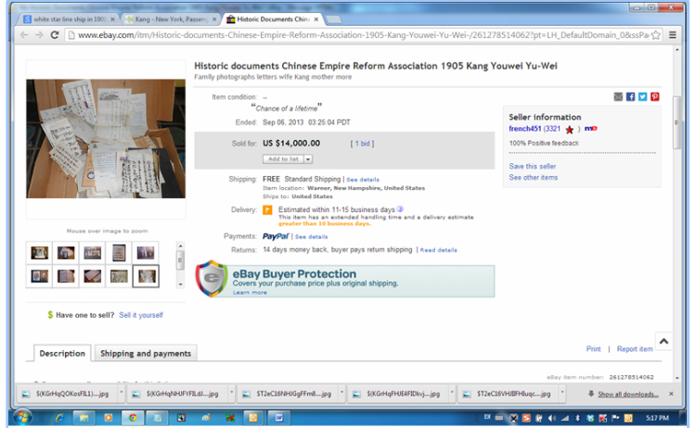
Jane Leung Larson: Process Slide
History will be the final judge.
How could the evaluation of character be determined by an individual's personal resentments or good will at a certain moment?
-Concluding sentence to Kang’s summation of his life to date for his students.
Notes:
We mostly asked her about her work on the Baohuanghui and her experience as the director of the Northwest China Council. Therefore, most of the information we got involved that. What we did during the interview was take turns asking her questions and if we heard something interesting, we would ask her about it. For example, when we were discussing her presentation on Kang Tongbi, she see was glad to discuss it. When we got to the part where she discusses how they found important documents on ebay she seemed happy. So, we asked her more about it. What we found out was that Kang Youwei was a famous calligrapher so his works were being sold for the caligraphy.

