Slide 1
Ambassador Julia Chang Bloch
First U.S. ambassador of Asian origin
Born in Chefoo (now Yantai), China
Appointed ambassador to Nepal by President George H. W. Bush in 1989
Founder and current president of the US-China Education Trust.

Slide 2
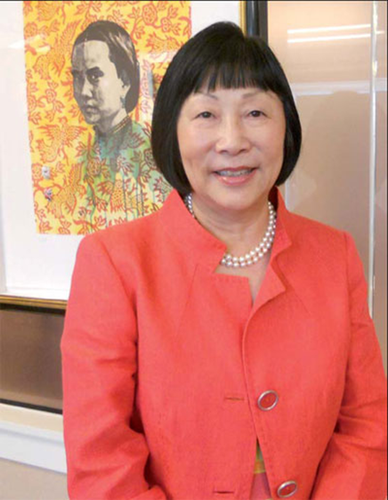
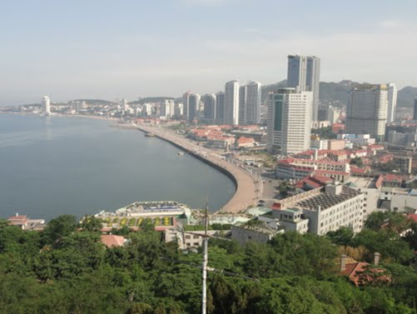
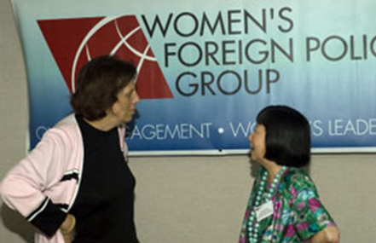
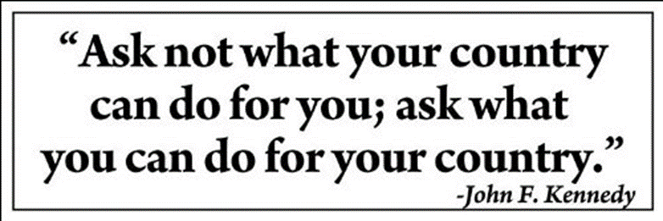
“Substance” Ambassador Julia Chang Bloch
Notes:
The mission of Ambassador Julia Chang Bloch can be seen throughout her career. She has broken down many barriers. More specifically with her current position as President of the U.S. Education trust, she has been focusing on breaking down the barriers between China and the United States; in order so that these two countries can better understand each other. Being the first of Asian origin to become Ambassador of Nepal and being a woman at that, she has used that as her motivation to go further and be successful in her career. Something that we took away from our interview was that although being a woman with such a high-ranking position, that should be all the more reason to succeed. Having a strong mentality and courage to prove others wrong can take you very far. Woman are going far and making enormous contributions to global issues today. The women of today, such as Julia Chang Block have set the bar for women of future generations.

Slide 3
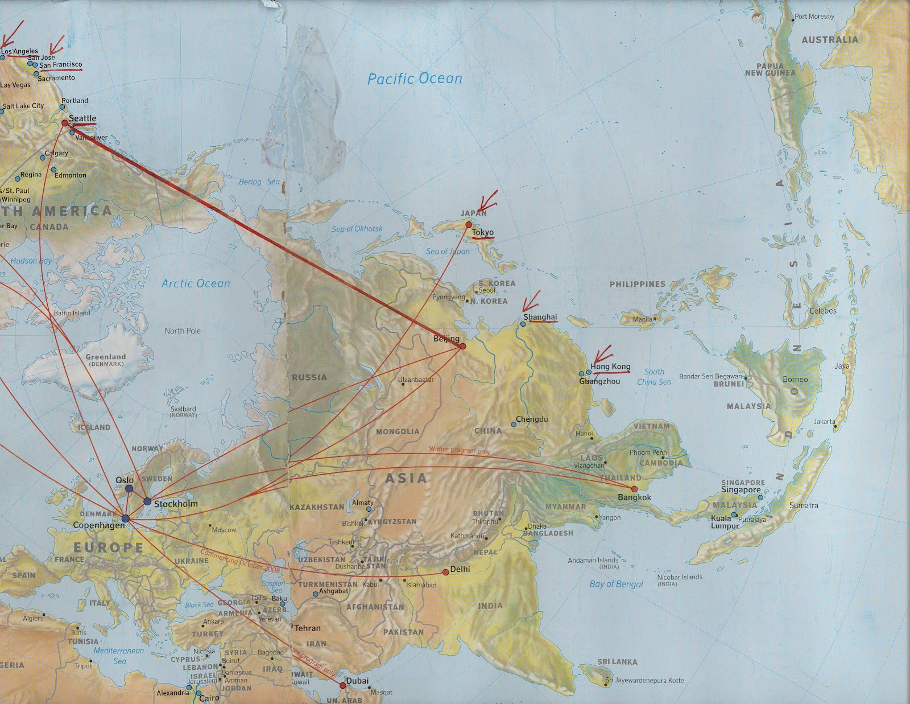
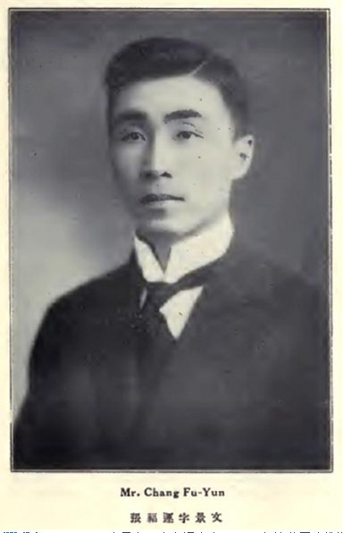
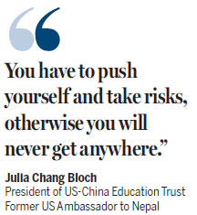

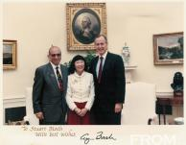
The Interview Process
Notes:
The questions we asked Julia Chang Bloch were created around what basic information we knew about her from both Professor Christoff and our own independent research. In preparing our key questions we knew that what and how we asked them would influence the type of information we would be able to get from the interview. Our objective was to learn as much as we could about the accomplishments of Julia Chang Bloch in the half hour we had to spend with on her Adobe Connect. The interview was held at 4:30pm on November 10^{th.}
We knew that Ms. Bloch was born in China and at the age of nine years old moved with her family to the United States. We started out by asking her about moving to a new country at a young age. We wanted to know what were the reasons for her move from China to the United States and what it was like as a young girl to move to another country. Ms. Bloch explained to us that it was an exciting time in her life. She stated that since she was a young girl at the time, it was her parent’s decision to move. Her father was not only a Harvard graduate, but the first Asian Graduate, and he had many friends in America that wanted him to move to the United States. She spoke about her childhood and stated that back in China she never went outside; she went from home to school and back home. Her Amah (her nanny) would drive her to and from school, she even said it was almost as if her feet never touched the ground! She was brought from one place to the next and really had no free time to play outside. She stated that girls of her generation did not go outside in China. Once she came to the United States she did not have an Amah and her parents were both working. She said that her and her brother got to play outside all the time and that even as a girl she felt free in the United States.
We asked Ms. Bloch about her time in the Peace Corp and wanted to know what it was like and what exactly was her driving force. We wanted to know about what inspired her. Ms. Bloch’s explanation in turn inspired us. She explained that her father had always told her that when your country does so much for you you have to give back to your country. His thinking was similar to that of another great man- John F. Kennedy. Ms. Bloch explained that it was the assassination of John F. Kennedy that was her driving force in joining the Peace Corp. As our previous slide showed, John F. Kennedy is famous for his quote, “Ask not what your country can do for you but what you can do for your country.” John F. Kennedy established the Peace Corp in the 1960’s and it was Ms. Bloch’s mission to be a part of it. These questions opened up quite a dialogue for our interview. She explained that in her time many young people were involved in social programs and that today it saddens her that the same thing is not so. She would love to see young people more involved. We talked about our class and she was very interested to hear about all that we had studied. We moved onto the US-China education trust and her passion behind it. With active listening we learned that it is her goal to keep the relationship between the United States and China a good one. Both countries are tremendous super powers and in saying that need to stay on each other’s good sides. She was very clear on explaining why it is necessary and that if her two countries did not get along it would not be a good thing. She believes that with programs such as the U.S.-China education trust that a good relationship between the two countries can continue and that the United States can continue to keep the peace.
Julia Chang Bloch explained to us that she has broken barriers all of her life. One of the best parts of the interview was when she told us the story about a little girl in Nepal. Ms. Bloch was appointed to Ambassador of Nepal by George H.W. Bush in 1989. Upon her welcoming visit to Nepal there was a little girl near her who was talking to her father. Within earshot of Ms. Bloch the little girl asked, “where is the American ambassador I want to see her.” To which her father replied and pointed that is her right there. The little girl then said, “ But she looks just like me.” Things like these are what has made all of her challenges worth it. Julia Chang Bloch prides herself on being able to represent her country well and at the same time being able to put herself in the shoes of others. She explained that when someone told her she wouldn’t be able to do something or couldn’t do something it was what made her push even harder. She was a wonderful interviewee and we really did enjoy interviewing her.

