Slide 1
Madelyn Ross
Denisse Ceballos and Ayodele Ajibade

Slide 2
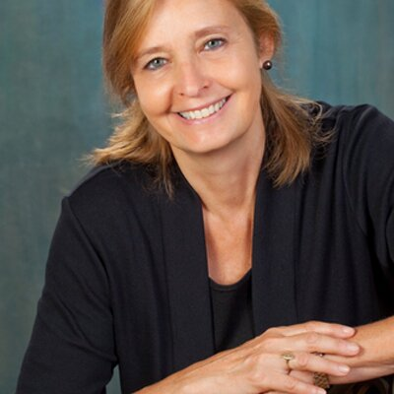

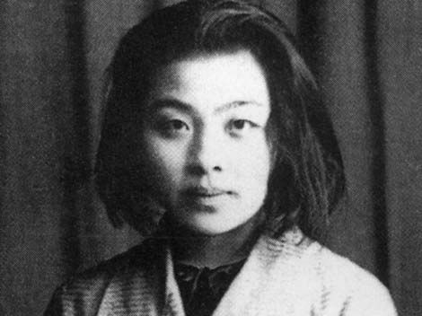

Background

Slide 3

Process
“Having an open mind towards seeing all sides of a problem is important. Go see the world and get to know how other people live. Put in the time to learn the language”
-Madelyn Ross (advice)
20:10-20:38

