Slide 1
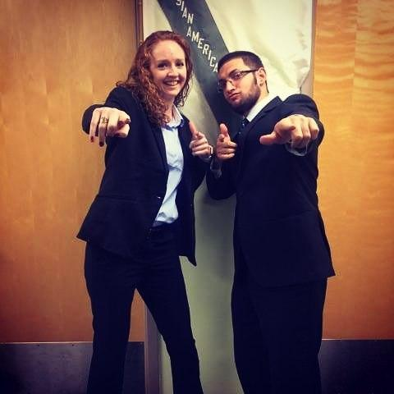
Helena Kolenda
Kristen Winters and William Ozdal

Slide 2

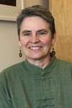

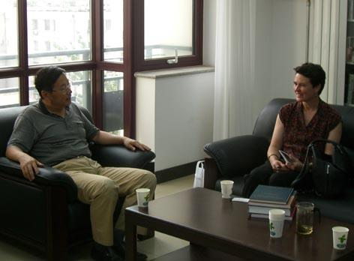
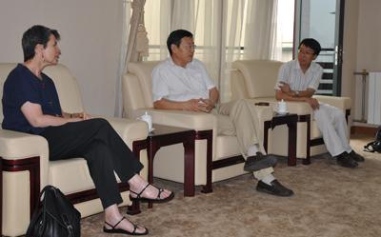
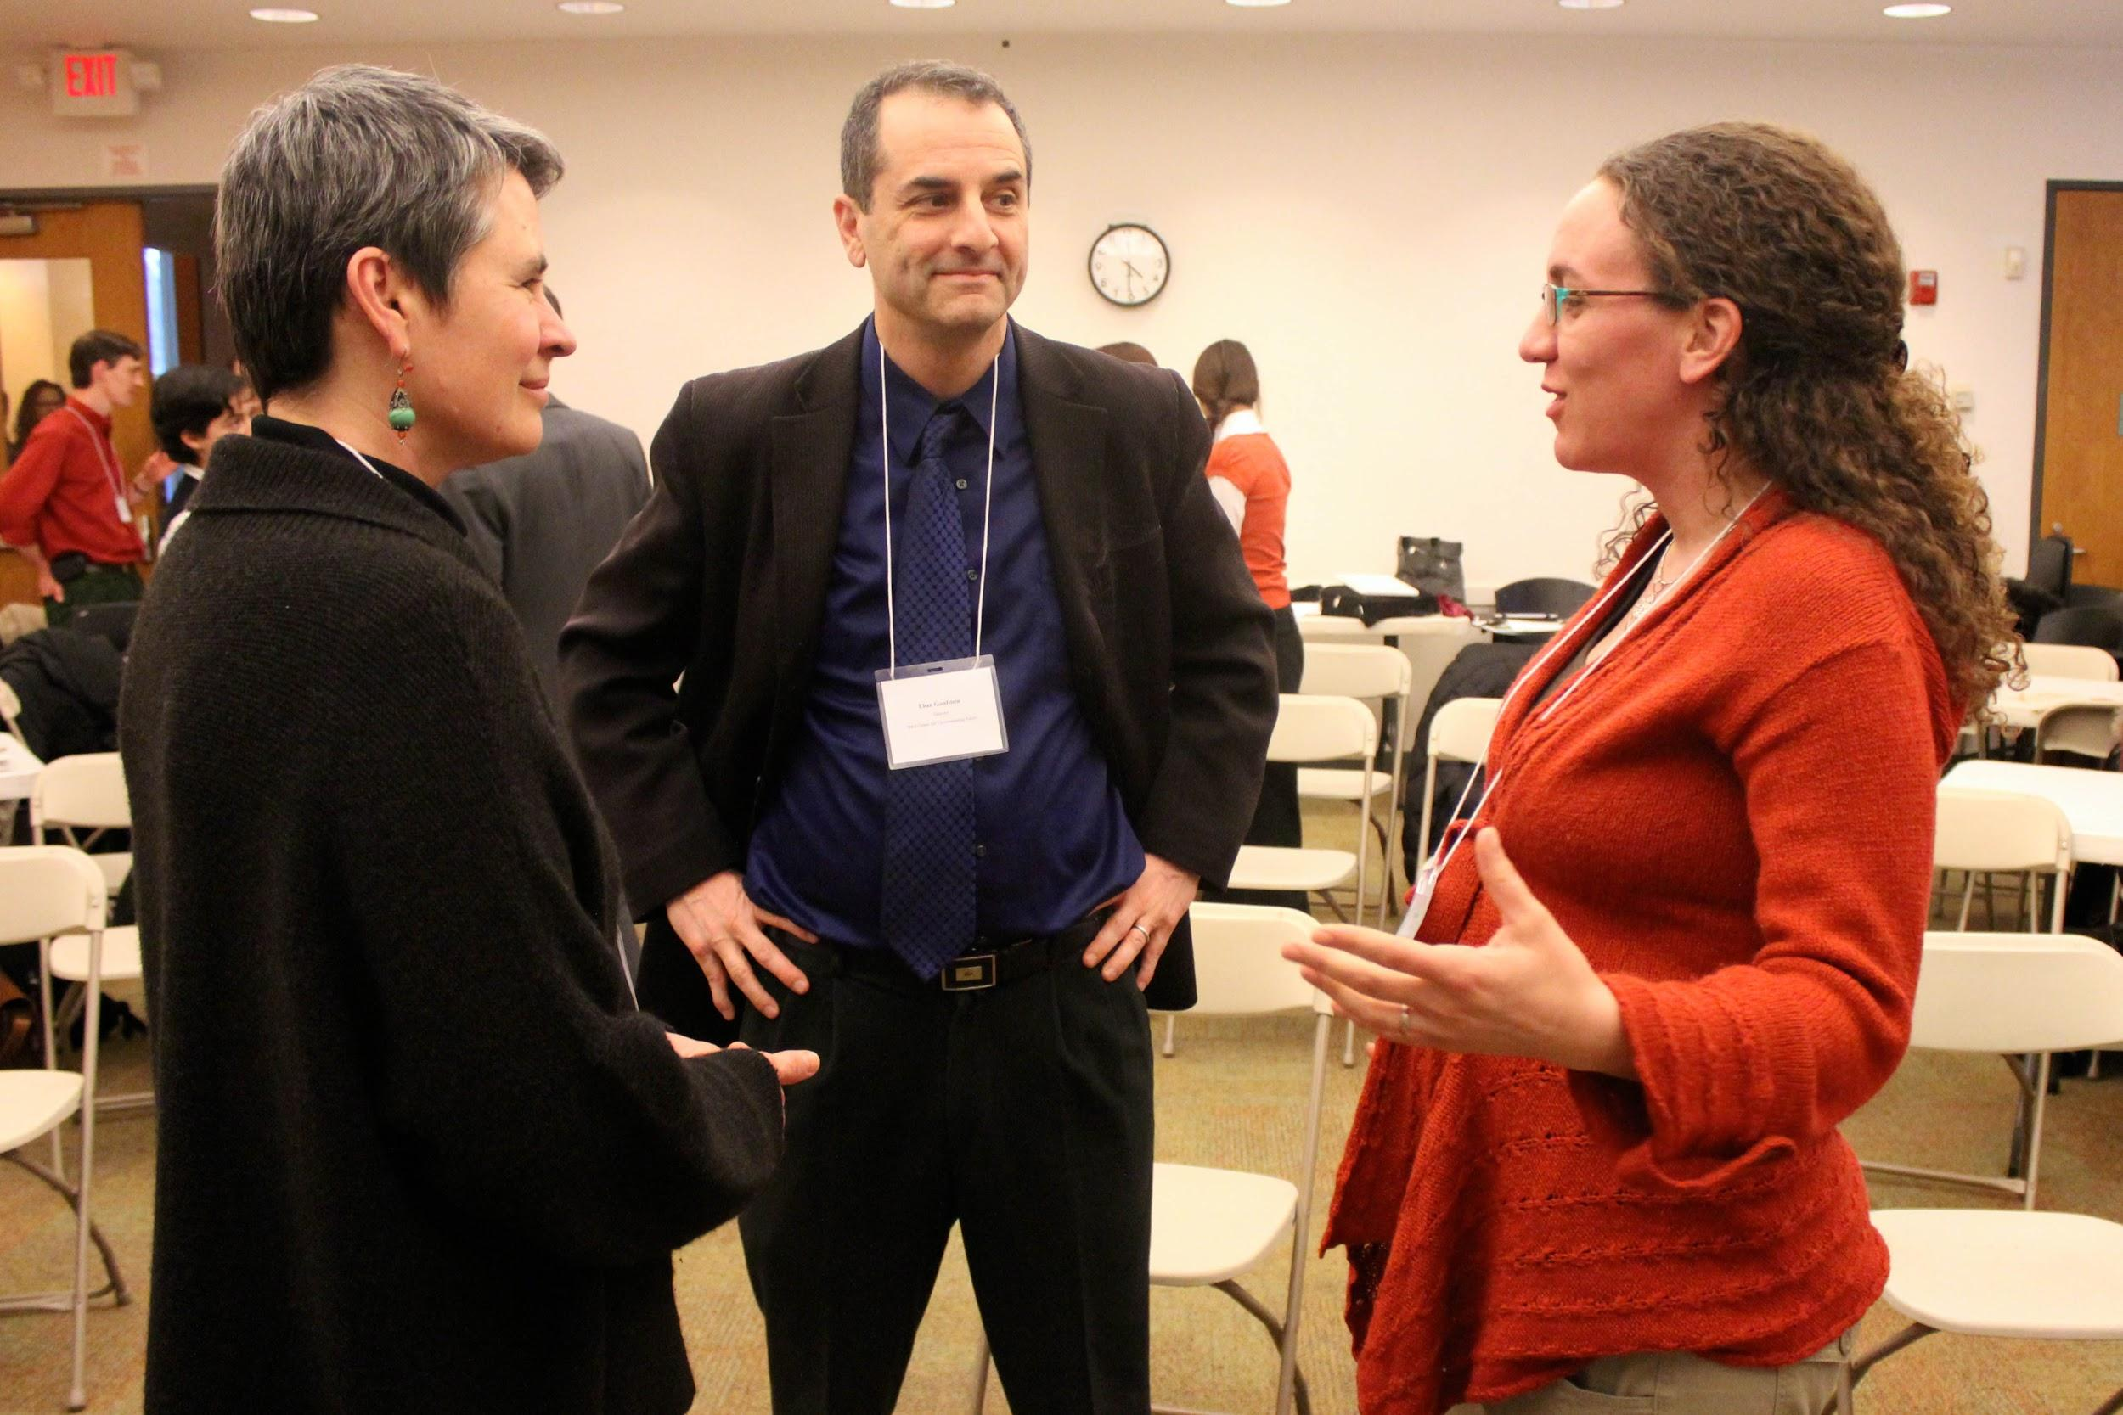
Content
Goals: Cultivate and promote a strong understanding and respect for Asian culture within American society and particularly American academics.
Current Field in U.S. Asian relations: Director of the Henry Luce foundation’s Asia program.
Notes:
Ms. Kolenda’s overall goal in life is to cultivate and promote a strong understanding and respect for Asian culture within American society. Throughout her professional life, she has continuously worked towards this goal. Between 1981 and 1996, Ms. Kolenda volunteered in China as an English teacher and then was hired as a paralegal for a law firm in Beijing shortly after. Through these experiences, she mastered the Chinese dialect of Mandarin and acquired a personal understanding of how the Chinese culture functions. Shortly after returning to America, Ms. Kolenda explained to us that she had started a family and decided that her occupation as a lawyer for a New York City law firm was very rigorous and not a family friendly career. As a result, she decided to alter her career path accordingly and landed a job in 1998 as a program officer for the Henry Luce foundation’s Asia program. In 2008, she was appointed to the position of director within this same program which is the position she still holds today. The Henry Luce Foundation’s Asia program has the main goals of fostering cultural and intellectual exchange between the U.S. and Asia and creating scholarly and public resources to promote a strong understanding of Asia within the United States. These goals are achieved through the process of monetary grant making to select academic institutions which is one of Ms. Kolenda’s main responsibilities as director. Overall, Ms. Kolenda’s careers and personal experiences throughout her life have greatly contributed to the topic of women in U.S.-Asian relations. She has worked to build a symbolic bridge between the United States and Asia and places a strong importance on educating America’s future generations on Asian culture. Overall, the information we obtained through our interview with Ms. Kolenda strongly reinforced several topics we have learned throughout this course. In addition, it was a very unique experience in that it not only solidified several topics within this class but also gave us a more personal and realistic perspective of women in U.S. Asian relations by allowing us to hear it first hand from Ms. Kolenda, who works in that field herself.

Slide 3
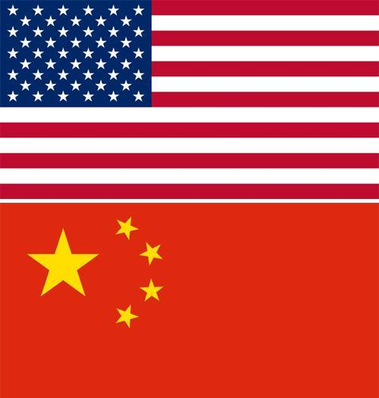
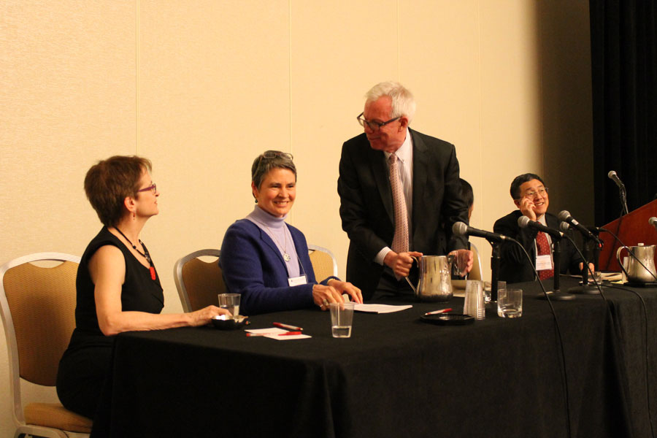

Process
Active Listening: Discussion about being discriminated against, follow up question about that thought lingering in the darkness. (4:27-9:08)
Non-verbal Signs: Lot of smiling, laughing, head nodding, agreeing. Made eye contact (or tried to)
Notes:
The interview lasted a little over an hour (1:01:40) We had a mixed interview structure. Prior to the interview, we prepared a list of questions from which we sent a few general questions as well as a few thought provoking questions to Ms. Kolenda, so that she had an idea what we would be discussing during the interview. This allowed us to not waste too much time coming up with questions on the spot and hoping that she would be able to answer them properly. We did find however, that some questions would be asked on the spot, in response to an answer that she had given us, which were examples of us actively listening. For example : After answering our question concerning any descrimination for being a woman that she felt might have been in her way as she was working in China, she answered by saying no, but she always got the feeling that they would have preferred working with a man. We followed up with a question asking if she would have preffered that to have been out in the open, rather than lingering around in the darkness. We did not have a set method for how we would ask questions, we just let the conversation flow naturally. Ms. Kolenda was very chipper and made having a conversation quite easy, even inviting us to tour the foundation if we are ever in the city! There was a lot of smiling and joking going on between us, which made for a very comfortable atmosphere.

Slide 4
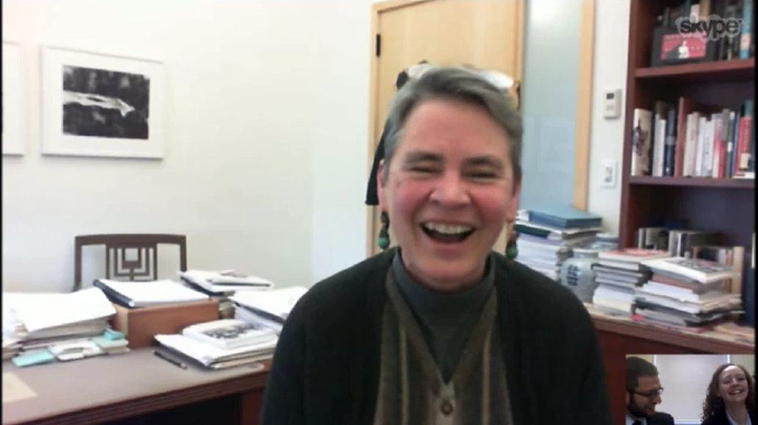
Question : “Why did you take a course that studied women in U.S. Asian relations?”
Answer : “It was a requirement!”
Notes:
Just a little humor! She loved it =]

