Slide 1




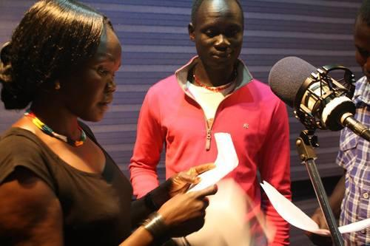
Content
Cultural differences
between East Asia & the US:
1) Bowing and handing over business cards with two hands VS. one hand
2) Relationship-driven VS. Transactional
Lack of childcare services in Japan
The significant role of media,
technology and data in driving world peace and in empowering women
Interests: “World Peace” “International Issues” “Telecommunication”
“Digital Media” and “Technology”
Influenced by her grandparents who travelled all around the world
Project: “Radio Drama” in South Sudan
(Sawa Shabab) and in Iraq (Salam Shabab) by “PeaceTech Lab”
Nancy Payne

Slide 2
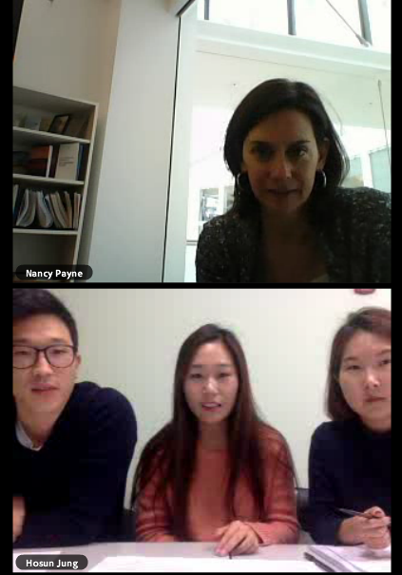


Process
On November 9th from noon to 1:00
Interview Purpose: Exploring her contribution to Asian-US relations throughout her current and previous careers
Mixed Structure Format:
Prepared Questions + Follow-up Questions
Active Listening: Ex) Outcome of Radio Drama
Verbal Cues/ Non-verbal Cues: Facial Expressions,
Gestures (Head Nodding), Eye Contact, Tone
Nancy Payne

