Slide 1

Sophie Richardson
Human Rights Watch
By Yalda Khwaja, Kofi R. Osei-Tutu, Lola Ashirmetov

Slide 2
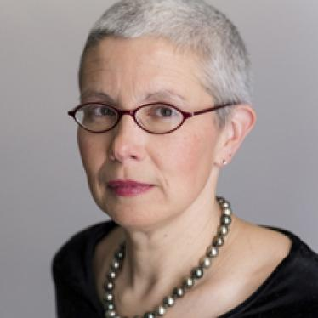
Content
Who is she?
China Director at Human Rights Watch
What are her goals?
Removing all of the discriminatory policies and practices that apply to ethnic minorities
Try to prevent human right violations in China
Etc
U.S-Asian relations
What did we learn?
Personal experiences used to relate to US-Asian relations

Slide 3

Process
Interview Process
From the first contact, through the interview, and to analysis
Unstructured Interview Format
Left room for development of conversation and information
Interview Atmosphere
Open and humorous - she was easy to talk to
Active Listening, Verbal, and Nonverbal Cues
Tools used to enhance conversation

