Slide 1

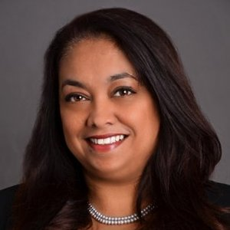


Content- Rosemarie Barnett
“The deck is not stacked in our favor - once you get the rules of the game you’ll be able to win - borrow from the men’s playbook”
Notes:
Biography
Rosemarie Barnett is an Immigration Rights Attorney based in New York, she was born and raised in an affluent family of 7 (3rd sister) in India and she has also spent time living in Taiwan. Her family encountered financial difficulties after the death of her father when she was 10 years old. After his death her mother made an emphasis on investing in an education rather than dowries (which was more typical in India), and was sent to an exclusive boarding school. She later attended a small liberal arts college in Massachusetts through a scholarship, and out of practicality she decided to obtain a Bachelors in Business, but her true dream was to become an Engineer (she was not able to pursue this due to finances and her school). Upon graduating she went on to her MBA, and took a class related to law which sparked her interest in pursuing a career in law. She met her husband while earning her MBA and has had 3 children between earning her MBA and law degree. Since earning her law degree she has worked at an elite law firm for 12-13 years and has since opened up her own practice.
Main points/relation to Asian American Women
Rosemarie has emphasized the importance of personal happiness and how ultimately life is a self-fulfilling prophecy. She talked to us about the many incidences she has faced due to the fact that she was an Asian American woman from being harrassed on a bus in India as well as being told by a hiring manager that she needs to be taking care of her children, despite being qualified for the position. In Order to overcome these barriers she emphasized that women need to become more assertive and appeal to others about their capabilities and to borrow from the “men’s playbook”
Reinforced things we learned in class - Mention relation to Missing 33% video
One of the questions we asked her was what is some advice you can give to women who want progress and get ahead in their career, and how different is this process in comparison to men. Video we watched in one of the lectures called the
“Missing 33%”, or why women could not become as successful in their careers in comparison to men. It was revealed that often times mentors would try to build the confidence of women, while they spent time teaching the actual business to men. Because of this difference in mentoring, the gap between men and women was developed.
Provided new information - Advice for young people finding their careers - Focus on trying to drown out negative voices, think about what you like to do. The bright side of living in this generation is that there are way more opportunities and options. In her generation the goal was working for a large company with great benefits. She mentioned internet business, bloggers and things that are unconventional, embrace the freedom and the opportunities that are available now.

Slide 2
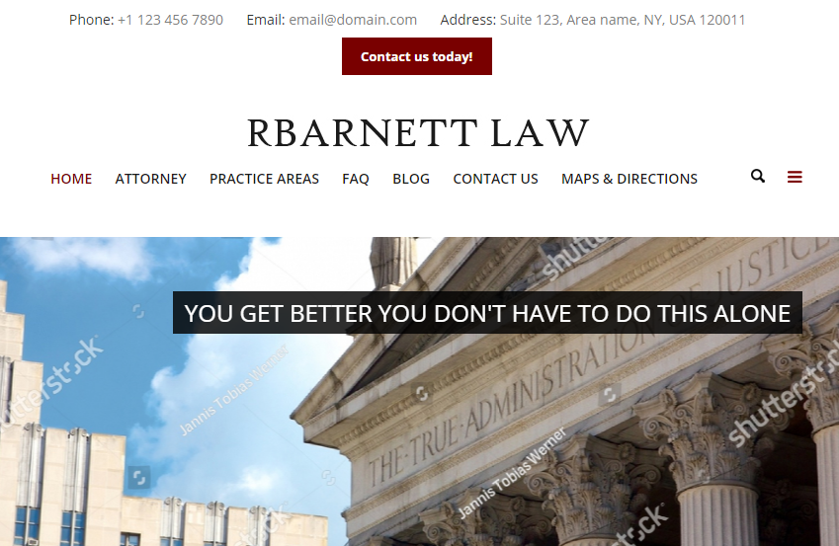
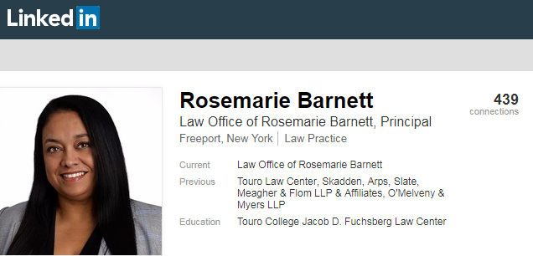
Process
Pre-Interview Research
Preparation of Questions
The Interview
“Let your work speak for itself, but also learn how to take an opportunity”
Notes:
Introduce clip:
How do you progress in your career/get ahead (as a woman) in India or the U.S.?
Are the rules of “progressing” up the ladder different for men and women?
Step 1: Pre-Interview Research
Once Professor Christoff told us which prominent Asian-American woman we’d be researching, we started with a Google search on Rosemarie, which led us to her LinkedIn profile and her professional website. Her LinkedIn provided us with background information like where she attended school, and her previous jobs at large law firms, which is where she started out. Her website led us to more up-to-date information on her current law firm that she runs, and the various cases that she has covered in the short five years since opening her own firm.
Step 2: Preparing Questions
Once we had a rough basis of Rosemarie’s life and work, we drafted questions that would give us more insight on her life growing up in India because the Internet did not tell us much about that, as well as some thought-provoking career-related questions like things the things she did to jump start her career and what kind of difficulties she has faced along the way because she is an Asian American woman.
Step 3: The Interview
We were very fortunate that the person we were interviewing was a great speaker. Whenever we would ask a question, even something basic like “Where did you attend school in India?” she would often go on personal anecdotes and give us even more insight than we had asked for, which was very helpful. She told us a lot about gender biases in India, and the challenges women face in today’s society to be taken seriously or just as seriously as their male counterparts. An example of a time where we used active listening was when she told us the story of how she came to be a lawyer, and we referenced parts of that story when asking a follow-up question on what she would have done differently on her path to success. In regards to verbal cues, the only noticeable changes in her tone was when she talked about her father’s death and the impact it had on her family (which is understandable because it’s obviously a heavy topic). Her body language throughout the interview was very relaxed, she kind of spoke to us like we were her kids asking for advice (because her kids are around our age) and because she was comfortable, we were also comfortable throughout the conversation.

