Slide 1
Yuriko Doi /
Substance Presentation
Presented by David Youngkyun Lee, Tiffany Huang, Kelly Liu

Slide 2
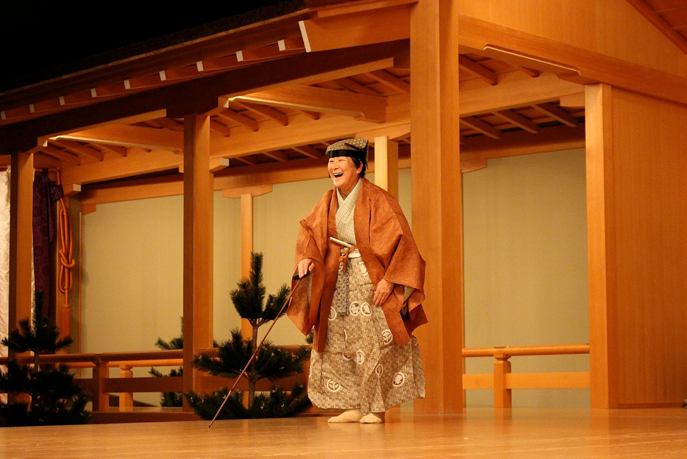
Mission/Goals
Yuriko Doi is a stage director,
choreographer,
performer,
and former founding artistic director of Theatre of Yugen.
She specializes in the fusion of traditional Japanese dramatic arts with modern world theater. (Noh and Kyogen)
Yuriko aims to share her heritage and culture through employing the concept of Yugen in her work.
Notes:
Talk about founding her Theatre of Yugen and its mission: Theatre of Yugen is an experimental ensemble dedicated to the pursuit of the intangible essence of yugen. With a foundation in Japanese noh drama and kyogen comedy, we create works of wo evolution of live performance and foster intercultural understanding. And by training and educating we keep the legacy of theatrical discipline is an important concept in traditional Japanese aesthetics.
The exact translation of the word depends on the context. In the Chinese philosophical texts the term was taken from, yūgen meant “dim”, “deep” or “mysterious”.
http://www.theatreofyugen.org/our-mission/
Forms of Noh and Kyogen, Mission to share these arts with American audiences and students.

Slide 3
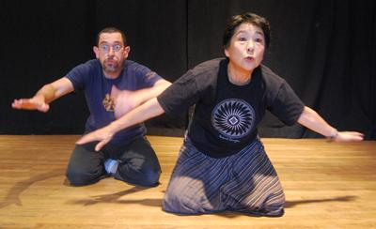
Relation to US-Asian Relations
Female practitioners of Yugen theatre were not easily recognized as professionals, even when having trained from a young age - a big factor besides gender was also religion.
Theater work was not substantially as biased against women as it was in other roles.
Audio: Yuriko Doi, her aunt influencing her interests in performing arts
Notes:
Japanese born. Trained in classical theater styles of Noh and Kyogen. Brought heritage to West in 1960s.
Stereotypes of Asian women in Film.
Racist ideals like Yellow peril that focused on asian community destroying traditional principles in the west.
This influenced asian women because female asian characters were created as a response to the growing asian population at the time. Usually as fillers. Not played by asian actresses but white women. Form of white washing.
Miyoshi Umeki. Similarily learned to play many instruments and performed in the states.
Sayonara broke boundaries in USA screen mouth to mouth kiss. Taboo fo sleeping with the enemy” where the film questions the post WWII mindset against people of asian background.
Asian women tend to be more aware of their culture. Surrounding issues of us-asian relations, women play an integral role to the preservation of asian ethnic identity in the face of acculturation.

Slide 4
Yuriko Doi /
Process Presentation

Slide 5
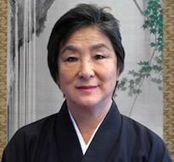
Interview Process
Open-ended questions gave her more to work with on how she chose to respond. She responded with a lot of stories and explanation. Very open to clarification.
There were moments where it was unclear if the question was answered, slight language barrier and sound was not very clear overall.
She smiled and laughed a lot throughout the presentation. She also talked with her hands and that happened especially more when she got into the story.
Notes:
Very personable!
Open ended questions lead to more narratives and anecdotal responses
Laughs a lot. Reminiscent.

