Slide 1
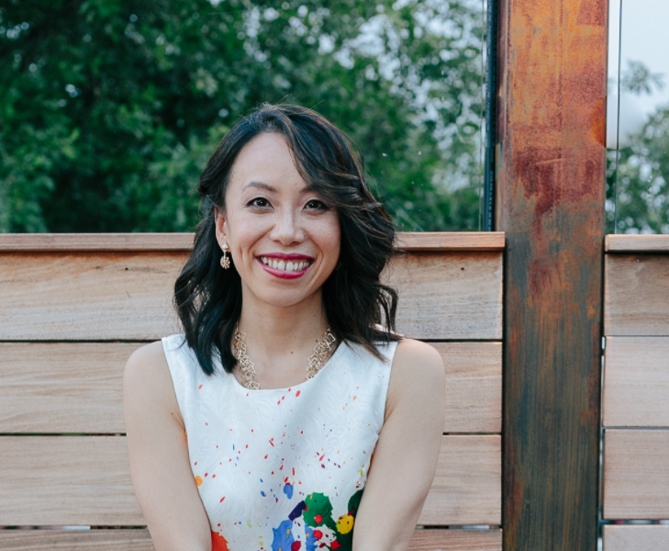
Gloria S. Chan
Presentation by:
Isabela Kernin and Bryanna Mojica

Slide 2

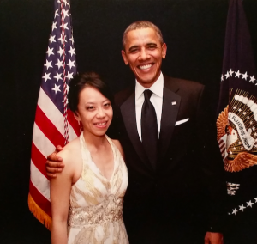

Content
Wanted to take advantage of the opportunity available to her and become a voice for the Asian American community; but wasn’t what made her feel alive
Realized she’d rather support and create to enact change than push against
Coaches to help a wide range of people overcome internalized problems, be confident and create
Notes:
->Isabela
Background:
-Refugee parents, grew up in a diverse community with little resources in Brooklyn and Chinatown
-Got into Prep4Prep, a rigorous education program that placed minority students into elite private schools; she wanted to take what opportunity she was given as far as possible -Felt pressure to speak for underrepresented communities (be her community’s Spiderman)
Early Career:
-Executive Director for the Asian Pacific American Caucus, Prez/CEO APAICS… realized politics wasn’t what she wanted to do, it was just a linear career path from where she started
-Thought of being a music manager because loved live music…realized that was similar to politics… wanted to coach to help people find their voice and courage
[First Audio Clip: Went to a liberal university where learning about how to be an activist meant pushing against old structures; as a coach she learned that being creative can be more impactful; need perspective and a balance of pushing and creating]
Currently:
-Works with a diverse group of people since humanity and struggle are universal. However, still really passionate about women and Asian American communities
-Looking forward to working with intergenerational women’s empowerment
[Second Audio Clip: When she was younger/in her twenties, she saw the Asian American community as a struggle based community that needed a voice. She now see’s it as a community that still struggles but is strong and works together to get by; a community that she can support rather than be a hero to.]
Relations to course:
-Gloria helps many people of color, including Asian American women, become better leaders in their personal and work lives
-She realized that you can’t just push to change old structures. This is similar to the Art of Social Change article we read where, for change to occur, you have to consider social and cultural context
-Gloria works with people who have been influenced by different cultural values (ex: parents valuing boys over girls)
-Exemplifies trend of future generations getting more involved in politics and activism than first generation
-New information we learned:
-Many second generation may feel like they need to take advantage of opportunity available to them (which can change into feelings of obligation) or they may feel like they are not deserving of the opportunity available to them
-Goals of immigrants and second generation are very different. First generation mainly focuses on getting by or bringing family over; second generation focuses more on improving life and leaving a legacy

Slide 3

PROCESS
Planning
Pre-interview research
  Website, Linkedin, book
Open ended, close ended, probing questions
Team interviewing approach
2. Conducting
Unstructured
Friendly conversation
Active listening
Tone
Verbal cues
3. Documenting
Used recorded conversation and notes taken during interview
Notes:
->Bryanna
Planning
Pre-interview research (website, Linkedin, part of her book on Amazon)
Used background information to prepare key questions
The questions you ask can influence the type of information you are able to gather, but Gloria was talkative, informative, & answered before we could ask
Open ended (“Can you explain the type of environment you grew up in?”)
Close ended (“Who would you say had the biggest influence on your drive?”)
Probing questions *Clip #1*
Talking about things that may have discouraged her during her journey; she said the pressure she always felt to take full advantage of her opportunities and to milk every privilege to the fullest ended up becoming discouraging for her (Harvard)
In 20s: she did everything she felt she was supposed to do (cared about policy implications for AA communities, so she went to capitol hill and became executive director of the CAUCUS. Then became President-CEO of the sister non-profit of that CAUCUS [APAICS])
Today: She’s not trying to milk priviledge or climb anymore
*clip #1* Bc I probed her, we got a better understanding and good information on her career choice
Prepare logistics for the interview
Team interviewing approach:
Original plan: divided questions equally by section; Primary note taker = Whoever wasn’t questioning, would take notes
I ended up conducting most of interview and Isabela took notes
Video conference → Telephone (~1 hour long)
Conducting
Type of interview: Unstructured (seeking her opinion/perspective, questions flexible and dependent on the interview & responses)
Friendly (professional) conversation
Active listening - *clip #2* - using her passion to find her career; i repeat to understand
Responding to challenging situations (realized info about children private so didn’t ask anymore)
Cues:
My non-verbal: Voice (loud, clear, confident)(avoid fillers, “uh” “so”); encouraging feedback; repeat when understand; rephrasing when don’t
Documenting
Isabela took most notes
*Clip #3* - shows Gloria’s personality. Began and ended interview speaking about Asian-American relations

