Slide 1
Lucille Barale
By Stefanie Chen, Paul Nguyen, Christolin Michel

Slide 2


Slide 3
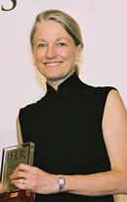
Content
What was your interviewee’s mission or goals in life and how is she fulfilling this?
How does her mission or goals relate to women’s roles in US-Asian relations?
What did you learn from the interviewee that
    Reinforced things we learned in class
    Provided new information

Slide 4
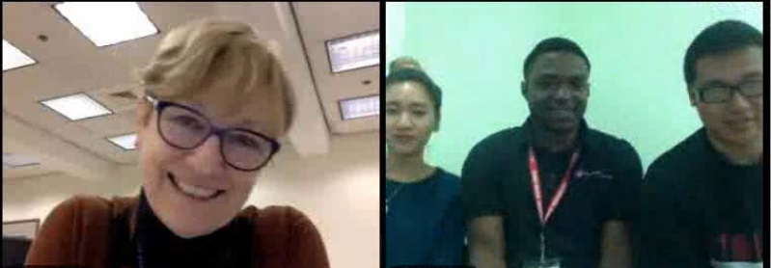
Process
How did the questions you asked your interviewee influence the type of information you received?
What were some of the verbal and non-verbal cues?
If working in a team, explain your approach and provide an example of your active listening.

