Slide 1
Vanessa Johanson
Country Director, Myanmar. USIP
By: Krystyn V. Phillips

Slide 2
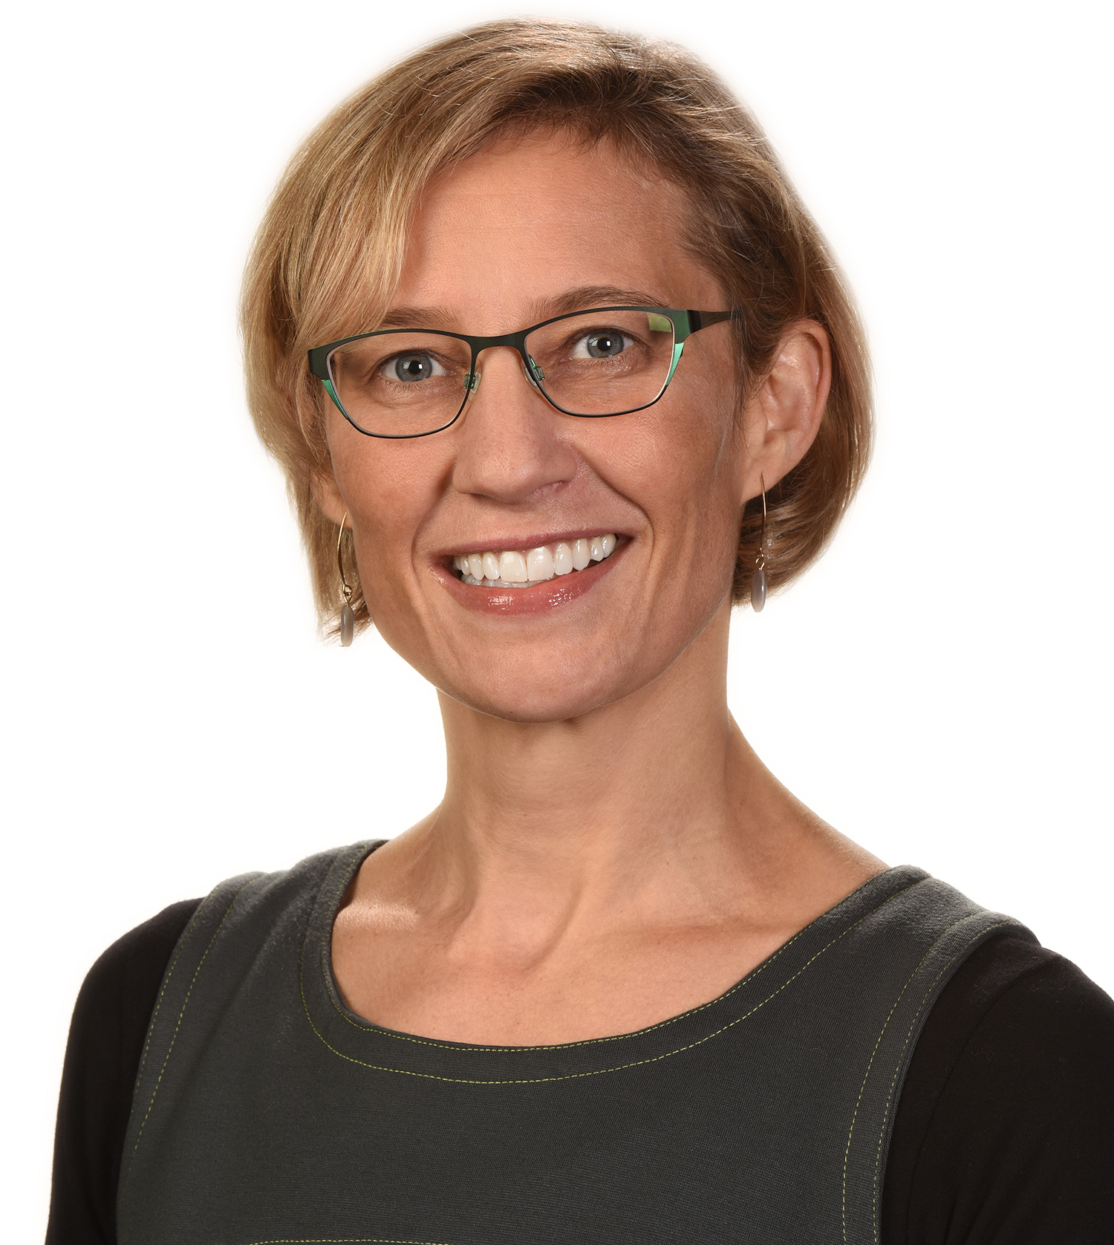
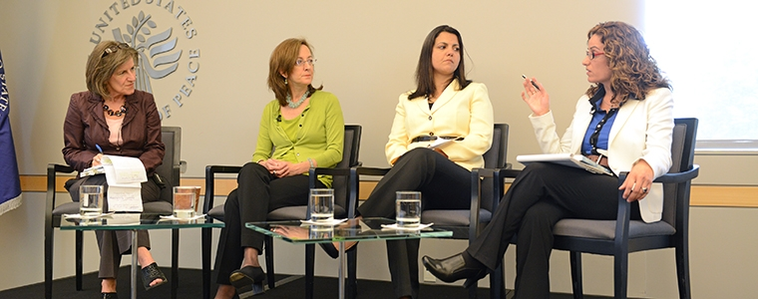



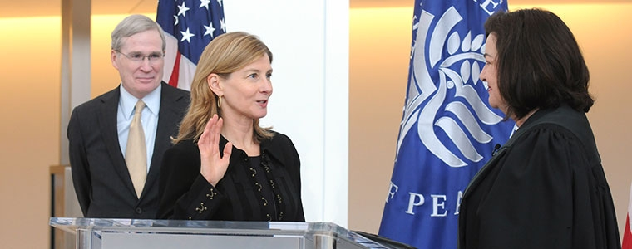
Content
Mrs. Johanson is the Country Director for Myanmar and her goals are to find the roots and causes of conflicts and therefore create strategies to avert violent altercations. She partners with numerous affiliates from the local level while using resources provided by USIP to help parties facilitate dialogue. Her specific involvement highlights the roles that women are stepping into politically and nationally; taking firm control over. She encourages the women in her community to engage positively in their society during conflict and after during reconstruction. Although she has made steps, Mrs. Johanson actively encourages everyone to include women in the whole process (excerpt above) of bettering the region so they may all prosper socially and economically.

Slide 3
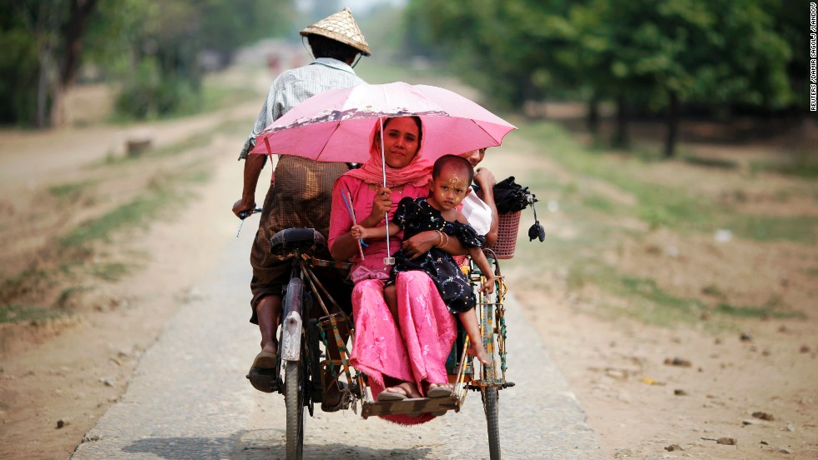

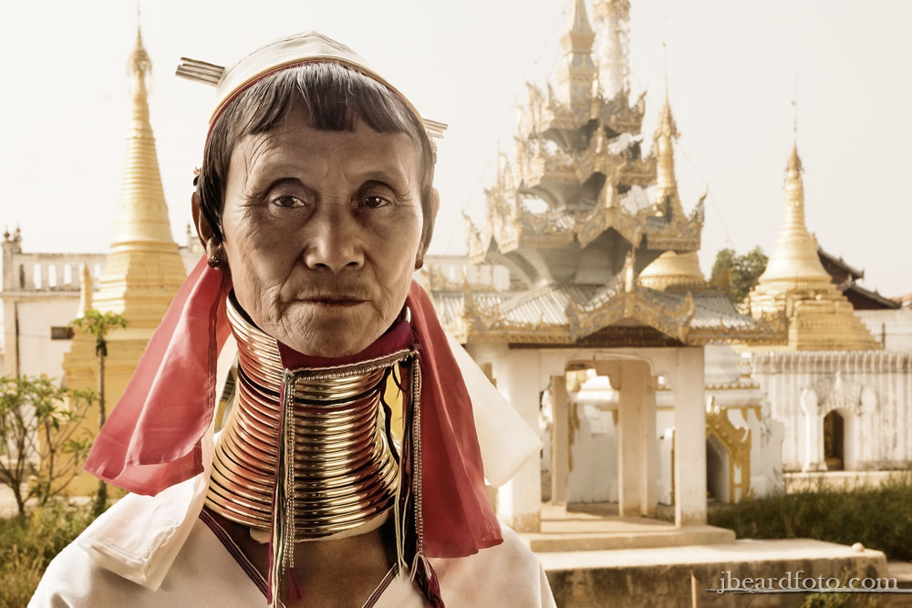
Process
During the interview, at one particular point I wanted to see just how applicable a concept I had studied in the course could be: That of assimilation. My question was based off of my findings in my readings and it held importance to me in the fact that I was curious to how tact, time, and the understanding of another setting might help to ease the transition of Mrs. Johanson into a foreign culture such as Myanmar. Mrs. Johanson put an enormous amount of thought into how best to answer my inquiry. Her musings were accompanied by verbal and non-verbal cues, such as: humming as she thought, light laughter as she considered one thought over the other, head tilted at and angle with her fingers touching her chin and with her eyes focusing upwards to concentrate.
The result of her careful deliberations produced insightful answers that in turn created settings for excellent follow-up questions on my part.

