Slide 1
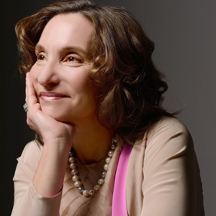
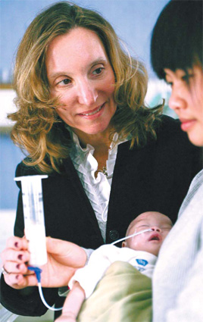
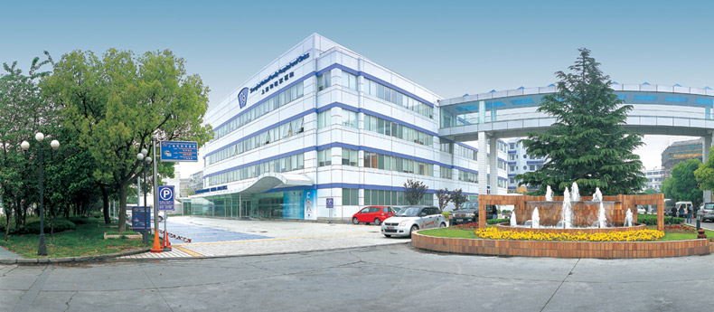

Robert Lipson: United Family Healthcare
“I think that increasing understanding through contact on the grass roots level, you know, on this side in China, showing people a really ethical place to work. We have over two thousand employees and over the years maybe we’ve touched ten thousand people’s lives or more. And patients, certainly hundreds of thousands, millions of people. And to show that coming from an international US originated company, I think has been wonderful. I’m a real believer in grass roots, people to people understanding.” –Roberta Lipson, 2018
Notes:
Roberta Lipson is the cofounder and Chairwoman of United Family Healthcare, the largest operator of for profit hospitals in China. Roberta founded its flagship facility, Beijing Family Hospital in 1997, after earning the trust and respect of Chinese officials; many of whom were skeptical at first of privatized healthcare services in China, given their sordid past. As we’ve learned from the article Opportunities and Obstacles for Women Physicians in the Twenty-First Century, ”the mere presence of more women in medicine is not enough to produce a better healthcare system”. Roberta represents a shift towards equality within the governing bodies of hospital systems. Not only does Roberta act as the Chairwoman of United Family Healthcare, but she also routinely serves as a board member on both the American Chambers of Commerce in China and the U.S. China Business Council. Roberta spoke on the gender disparity she routinely sees in her professional life. (Play clip 19:15- 20:11) This disparity has not caused Roberta to become callused or defensive. On the contrary, as she puts it, “we have a […] consensus-driven leadership approach in our company, and I wouldn’t change it so I could look more like a man”.

Slide 2
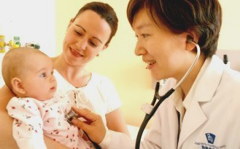

The Process:
Key Questions
-How would you say that you’re career has affected your family life?
-What's the corporate culture like there? Is it predominantly men?
-Where do you think your company has played a role in terms of U.S./Asian relations. Do you think that you’ve opened up more diplomacy? Do you think you’ve softened relations? Do you think your company has played a role in that?
Observations
Meeting took place early morning for Roberta but late night for us. She was just about to start her day and gave us the courtesy of an interview. She was pleasant, patient, and determined to do the video interview despite the internet interference. She was also surprisingly humble for a person in her position.
Conclusions
Roberta’s down to earth attitude and passion for what she's doing resonates in her work. She’s able to stay true to herself as a woman and still foster a bridge between two nations through her ideals in the medical field. She is a woman to be celebrated in our opinion.
Notes:
The questions we asked Roberta Lipson were centered around her personal life and how her successful businesses have affected it. Being a woman in her position within a patriarchal country may be hard for some, but Roberta seems to handle it with grace and humility. She goes in depth about how she was able to give her all to her business. (quote) basically reiterating the “it takes a village saying”. In hindsight she does wish she could of spent more time with her family but she knows they’re proud of her nonetheless. She goes on to speak about the future of United family Healthcare by stating what her initial goals were and how the company has reached and exceeded her expectations. (quote) By evolving with the times but still keeping true to the initial identity of the company United Family Healthcare.

