Slide 1

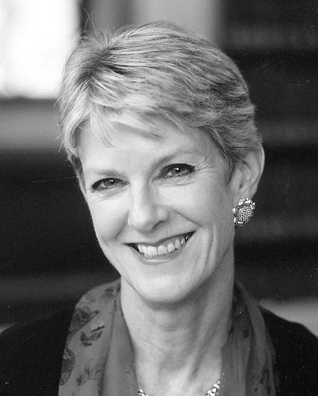
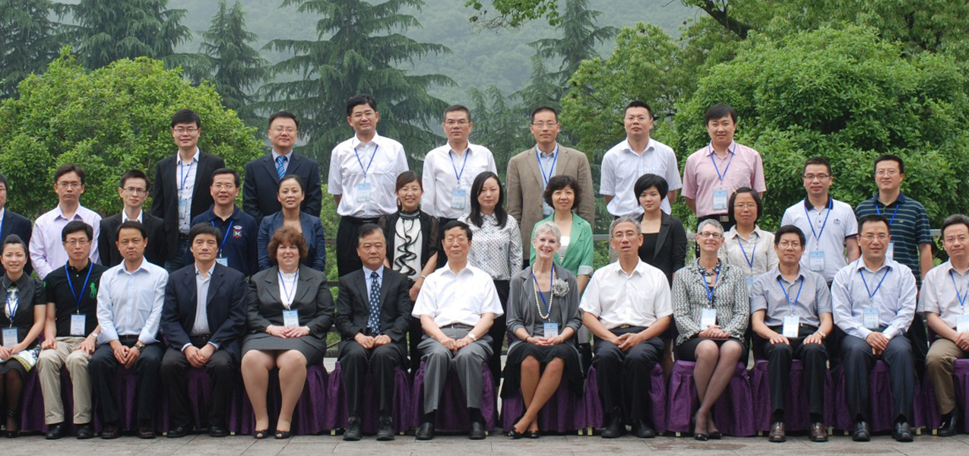
Jamie Horsley
Substance
YALE RESEARCH SCHOLAR
COMMERIAL ATTACHE
INTERNATIONAL LAWYER
Notes:
Jamie Horsley is a Research Scholar and visiting law professor at Yale University and the Executive Director of The China Law Center at Yale. Previously, she was a partner at the international law firm of Paul, Weiss, Rifkind, Wharton and Garrison, a commercial Attaché in the U.S. Embassies in Beijing and Manila, Vice President of Motorola as well as the Director of Government Relations for China at Motorola, and a consultant to the Carter Center, where she worked on village elections in China. Ms. Horsley focused most of her career on improving China as a whole. She has worked on Chinese Legal reform and believes that the Chinese people should be more involved in their government, but the government does not allow the same amount of participation as the U.S. does. She believes China is progressing and is changing for the better even though the common misconception is that China is not yet a democracy, so they haven’t grown. Her work helps women and men in China reach their fullest potentials as citizens, and in a country where women are not holding, for the most part, high governmental titles, she hopes that reform and higher participation will facilitate change for women. She reinforced that China is often closed off and untrusting of the intentions of Americans abroad, but once you make connections, the Chinese people are warm and friendly. She also discussed the severe censorship that occurs across social media in China, just like the censorship of journalists in China which we discussed many times in class. She has seen this censorship first hand, and it led her and her family to come back to the U.S. in order to raise her children in a more open environment. We hadn’t discussed the social media aspect in class yet, so it was refreshing to her a current viewpoint of censorship in China.

Slide 2



JAMIE HORSLEY
PROCESS
Notes:
We created questions about Ms. Horsley’s career because it was so diverse and interesting. We had questions specific to each position she held in order to get a better look into what she has accomplished over her vast career. These questions helped us get answers that were expansive and would lead to ideas for new questions. Most of the interview focused on her work IN China, as opposed to work she did at home in the U.S.. She spent many years abroad working with China and the U.S. first from the commercial side, and then to the political side, where she gained many important colleague relations that benefitted her throughout her career. We conducted a Skype interview that was an hour long. Since we were interviewing on Skype, we both asked questions to Ms. Horsley, so we split the work evenly. We both actively listened to what Ms. Horsley was saying throughout. For example, Ms. Horsley discussed the Millennials of China, and how they’re creating so much change. Dan, then, decided to discuss with Ms. Horsley how this is a trend we’re seeing today in the U.S., to which Ms. Horsley agreed. As far as non verbal cues, Ms. Horsley smiled throughout, especially when discussing her early career as a lawyer. You could tell that she really enjoys her life work and thinks fondly of the time she spent in China. She laughed and smiled throughout, so she seemed to really enjoy the interview. She tended to look up and pause when she was initially unsure of how to answer a question, but it would only be momentary, and then she would continue to speak.

