Slide 1



Mary David – Interview Content
Her goals are to create change and raise awareness about human trafficking
Using her status and privilege here in America to help those who don’t in Asia
In framing a question on the “Spheres of Influence/Identity Model” Ms. David answered that she is fully both “Asian” and “American”
Working to create local change by small things, such as art performances.
The victims of human trafficking come from every type of background (particularly education wise) and are not necessarily related only to the physical movements of people, but rather those who are forced and exploited.
Target audience - youth versus adults
Notes:
Our group interviewed Mary David. She is a lawyer and an advocate for anti-human trafficking. She received her JD in 2012 from George Washington University Law School. She is currently assisting the Judge-in-Charge of the Criminal Division at the Baltimore City Circuit Court with various aspect of adjuncting felony cases.
Mary David has sought to create change and raise awareness about human trafficking, through policy making, education through the arts and working in and with different levels of government, both domestic and abroad. Ms. David has held esteemed positions such as Advisor for Timor-Leste where she dealt with counter terrorism, the country’s first elections, and human trafficking.
Mary David is using her status and privilege as an American woman to help those who don’t have the same rights. Ms. David reminded us of Anna Louise Strong and Pearl S. Buck. Ms David uses her beauty pagents, spoke word performances, and dancing as an access point to various audiences that are often over-looked in regards to social change.
In class we learned about the “Spheres of Influence/Identity Model” and Ms David stated that she sees herself as being both “Asian” and “American” and dislikes the labels that would confine individuals to one category or another (Interview audio insert). She is a woman who helps the world. Looking at the “Ten Methods of Social Change” we reviewed in class, she utilized several of these methods, such as dialogue, education and consistency. Upon hearing Ms David talk about human trafficking we were reminded of the “East Asian Women in the Military” and the comfort women that were mentioned and how it related to modern human trafficking.

Slide 2

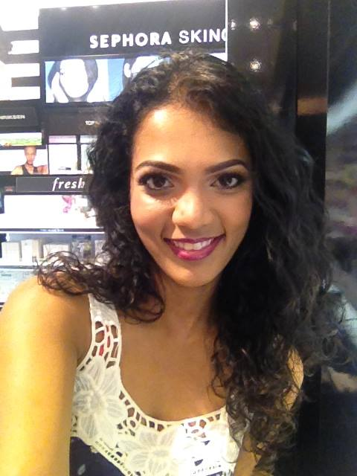

Mary David – Interview Process
Had issues coordinating schedules and working with Adobe
Interview via Skype with audio recording
open ended questions and a mixed structure format
Split up questions between us and all took notes at different points so that we were not taking them at the same time and everyone was engaged in interview
She went back to answer a previous question from earlier in the interview (showing comfort environment)
Notes:
Before even formulating questions, we thought it wise to research Ms. David and ascertain information a bout her that she may not have included in the CV that was forwarded to us by her. After deciding on the points that we felt were more important, we formulated our questions. In contacting Ms. David it was difficult working around scheduling conflicts amongst the four of us. Originally we had a date set, but since she could not access Adobe via her work computer our meeting had to be moved to the following Sunday. Even on that day we were unable to get video from her end in the Adobe Connect Room and so we had to do our interview via Professor Christoff’s Skype account. We were unable to record video but we did record audio via our phones.
In our working as a team, we found that it best to spread the responsibilities of each of the jobs between us as a way to all be equally engaged with Ms. David during the interview. The questions were mostly open ended questions which created a mixed structure format that resulted in a very relaxed interview environment. We feel this gave Ms. David more room to bring up and expand on different points that she wanted to touch up-on further once the interview began to come to a close. We split up the original interview questions amongst ourselves and found it easiest to take each of our notes individually yet taking care to not all take notes at the same time. Because of this at least one of us was watching Ms. David at all times and that person could comment and progress with the interview while the others could nod and gesture to show continued engagement.
Even with an ordered set of questions for the interview, we ended up going in a non-linear fashion once the interview got going and ending up adding “spur-of-the-moment” questions and rephrasing already formulated ones to clarify points and gain a better response.

